Slide 1

Online Job Portal
Group 4
Yashwanth Reddy
Suraj Yadav
Pawanesh Singh
Om Patre
Naman Lad

Slide 2

Problem statement
Candidates ,graduates ,freshers or experienced have to travel a lot and search for jobs that suits them.
Also the process of recruitment can be complex and scale as per organization’s size Organizations across different verticals have to look for suitable candidate, place advertisement for interviews ,do screening for candidates conduct interviews ,and select suitable person for the job For this an online application is required that can fulfil requirements of both candidate and employer

Slide 3

User Stories

Slide 4
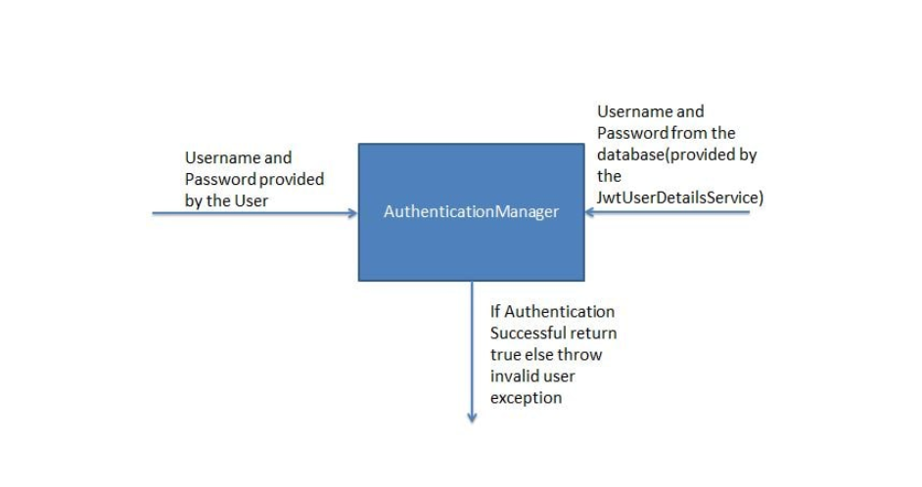
Register candidate and employer
1. Candidate/Employer should be able to register and login into to the site
Candidate should be able to create a profile by mentioning his details like educational qualification ,technical skills ,experience ,projects worked up on, at the time of registration
2. JWT Authentication For Candidate/employer login
After registration of the user the candidate/Employer can use their registered email and password to generate authorization key.
Use the generated token for accessing api’s

Slide 5

Employer and job
Employer Can create a job
By providing the location, salary, job description that includes skill required, and his own id.
Employer Can be able search candidates based on their skillset, location, experience.
Employer Can change interview Status
Employer Can close the job

Slide 6

Candidate and Job
Candidate Can apply for a job
Candidate can search for job using location and industry
Candidate select options to receive notification in desired category
Candidate can check status of a job
And also can check status of his application
Next he can also post feed back and rating

Slide 7
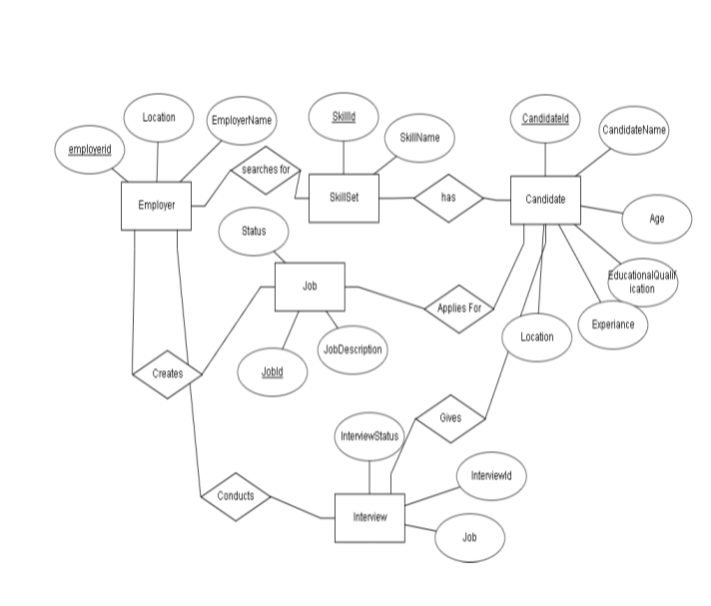
ER Diagram

Slide 8
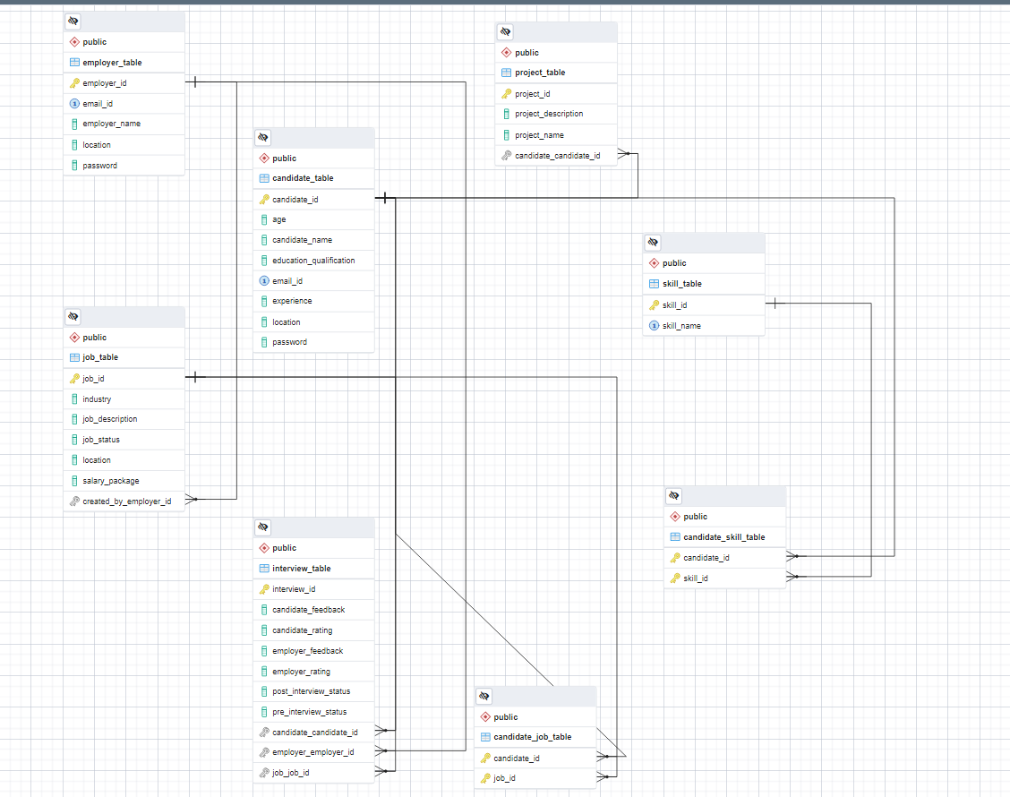
DFD

Slide 9

Thank You

